Slide 1
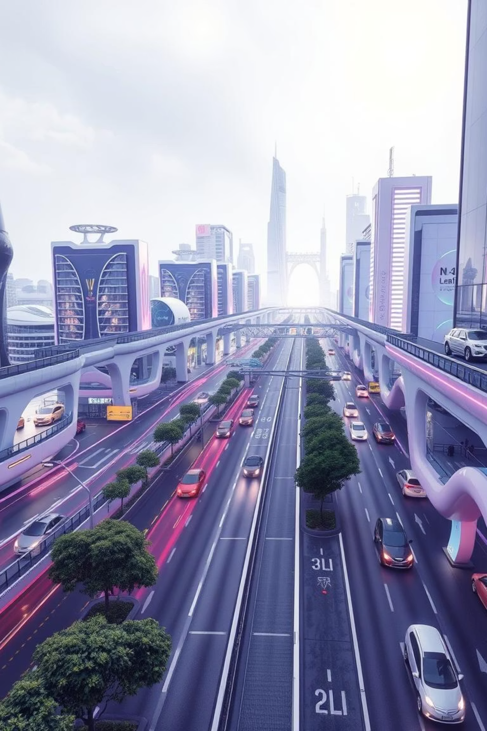
Traffictelligence: Smarter Cities Through Advanced Traffic Volume Estimation
Traffictelligence leverages machine learning to tackle India's urban mobility challenges. Global traffic congestion costs are immense, and India significantly contributes, with Bengaluru ranking second globally in 2023 for congestion.

Slide 2

The Growing Gridlock: Challenges of Traditional Traffic Management
Traditional methods are costly and limited, like inductive loops and manual CCTV analysis.
Lack of real-time data leads to inefficient signal timing and poor planning.
Indian cities lose INR 1.5 Lakh Crore annually due to congestion.
Vehicle emissions worsen air pollution, contributing over 40% of PM2.5 in major cities.

Slide 3
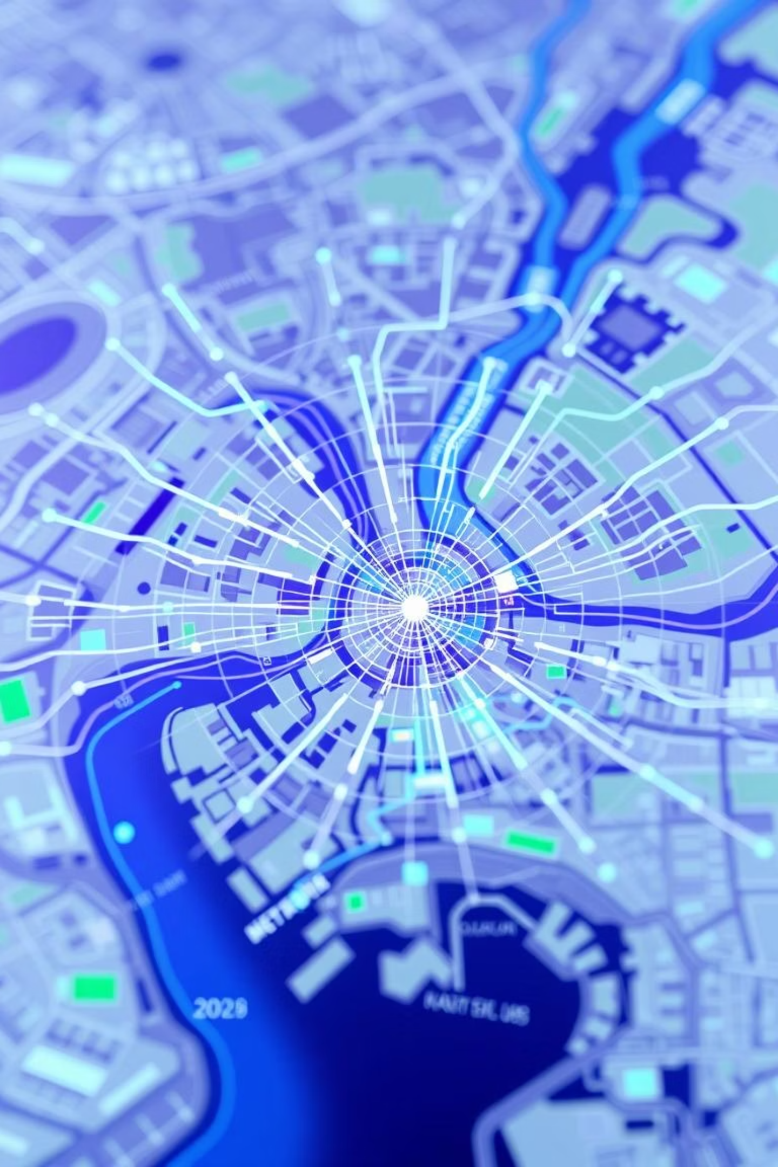
Introducing Traffictelligence: AI-Powered Insights for Urban Mobility
Holistic System
Integrated Data
Highly accurate, real-time traffic volume estimation for smart cities.
Combines historical patterns, weather, events, sensors, and mobile GPS data.
Predictive Analytics
Forecasts traffic trends up to 60 minutes ahead with over 90% accuracy.

Slide 4
Machine Learning in Action: How Traffictelligence Works
Data Ingestion
Feature Engineering
ML Models
Output
Gathers data from inductive loops, smart cameras, mobile networks, and weather APIs.
Extracts patterns based on time, day, and specific events like festivals or cricket matches.
Utilises deep learning (LSTM, GRU) for time-series forecasting and ensemble methods for robust predictions.
Provides granular traffic volume data for specific road segments and intersections.

Slide 5
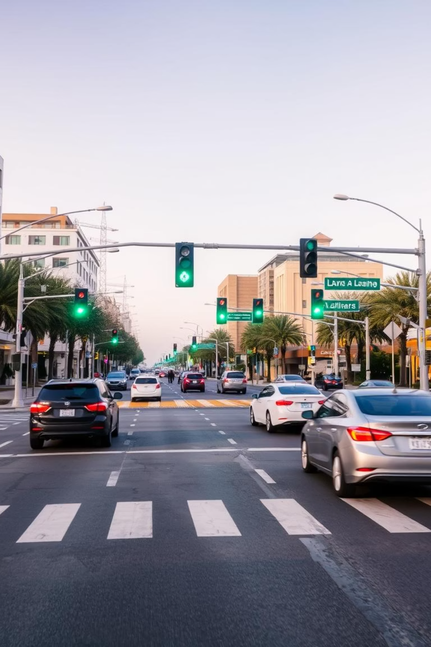
Tangible Benefits: Driving Efficiency and Sustainability
10-20%
5-15%
8-12%
Signal Optimisation
Route Planning
Reduced Emissions
Reduces average waiting time at signals.
Decreases average travel time on congested routes.
Potential decrease in CO2 from idling vehicles.
50%
Incident Response
Faster detection and management of traffic disruptions.

Slide 6
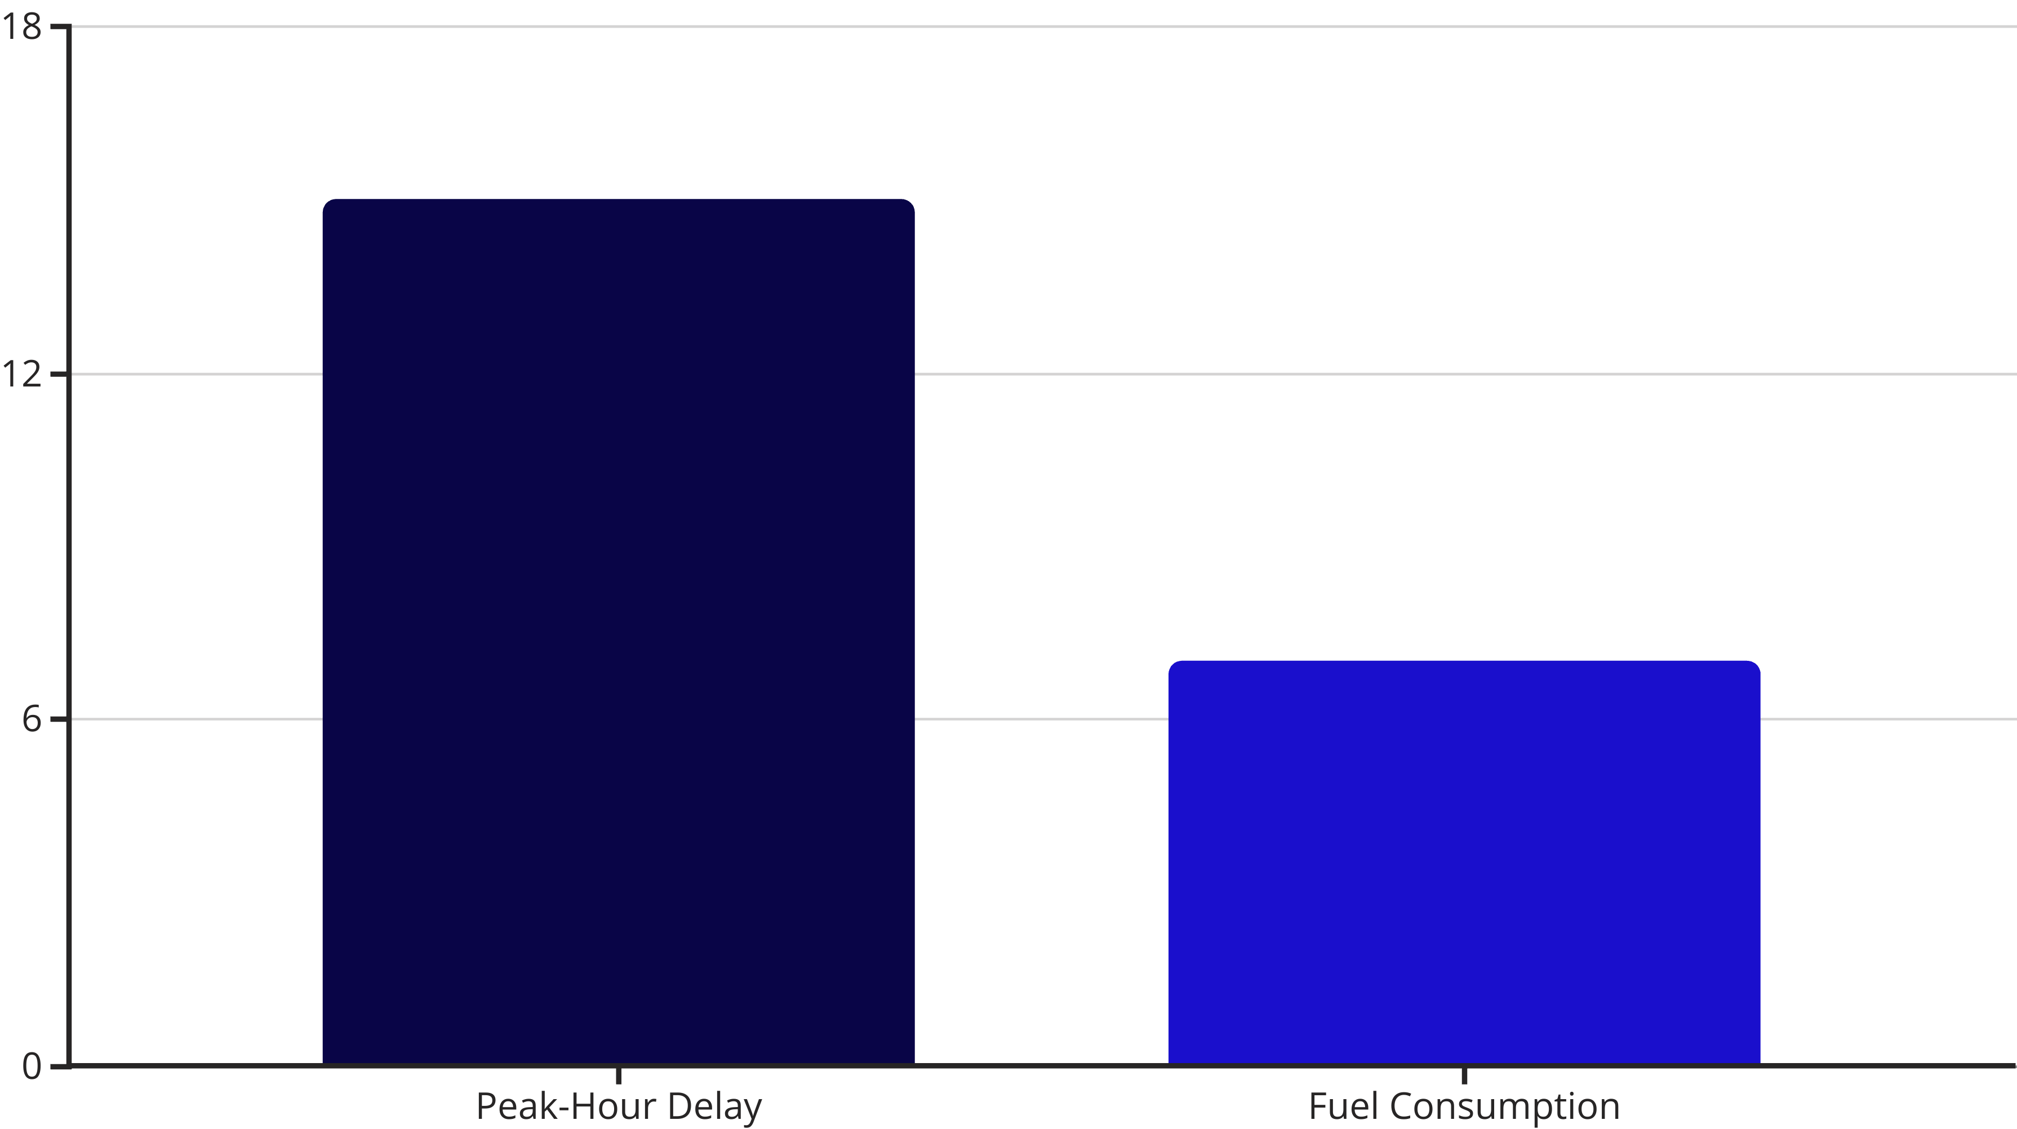
Real-World Impact: A Smart City Case Study
A pilot in Pune Smart City, across 15 intersections, demonstrated significant improvements. This project successfully reduced peak-hour delays and fuel consumption, proving its potential for wider implementation. Integration with existing CCTV infrastructure was a key factor in its cost-effectiveness.

Slide 7
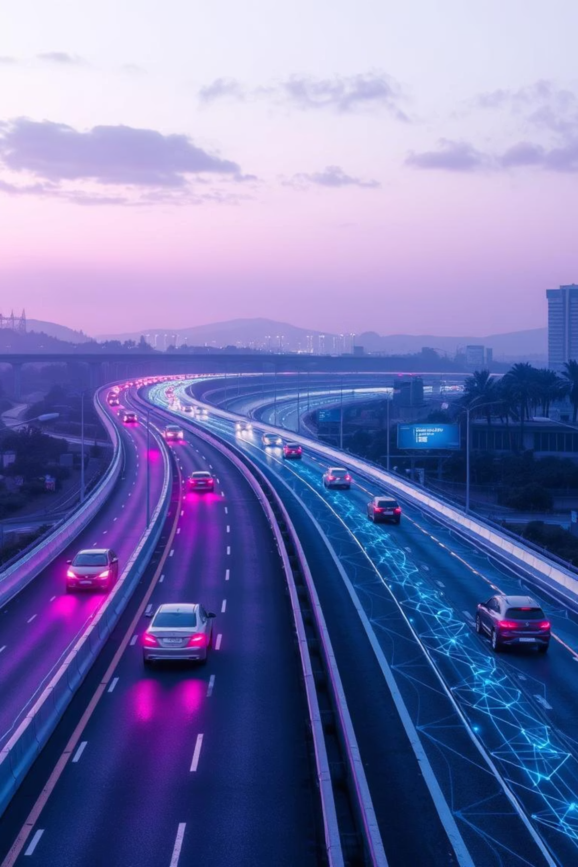




The Road Ahead: Future of Traffictelligence
Smart Infrastructure Integration
Seamless communication with V2I (Vehicle-to-Infrastructure) systems.
Autonomous Vehicle Optimisation
Provides critical data for self-driving car navigation.
Hyperlocal Predictions
Real-time pedestrian and cyclist volume estimation.
Predictive Maintenance
Forecasts infrastructure strain, aiding proactive road repairs.

Slide 8
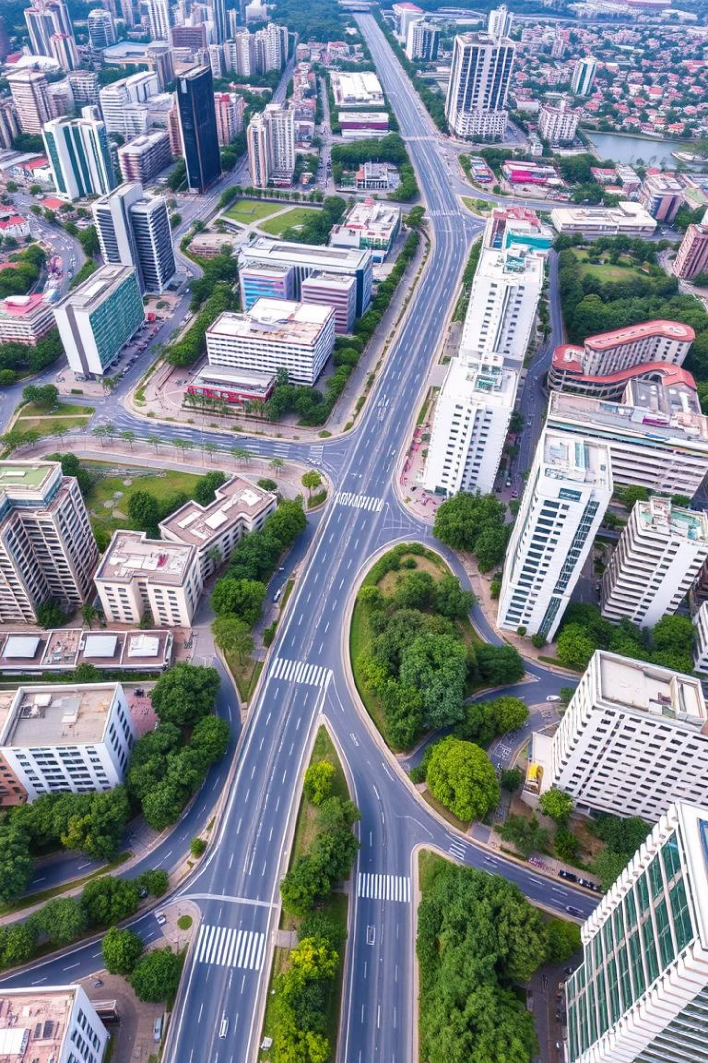
Conclusion: Navigating Towards a Smarter, Sustainable Future
Traffictelligence transforms traffic management from reactive to predictive. It offers significant economic, environmental, and social benefits for Indian cities. This system empowers urban planners with data-driven insights for sustainable infrastructure development, marking a pivotal step towards truly "smart" and livable Indian cities.

